Slide 1

Angular 8
Vivekanand P V

Slide 2
Agenda: Day 1
Overview
Environment Setup
Components
Data-binding
Templates
Directives
Q&A

Slide 3
Agenda: Day 2
Directives
Advanced Template Techniques
Routing
Hands-on Project
State-management
RxJS
Q&A

Slide 4
Agenda: Day 3
State Management
RxJS
Forms
Http Communication
Architecting Angular Apps
Debug, build, test
Road ahead
Q&A

Slide 5
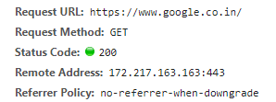


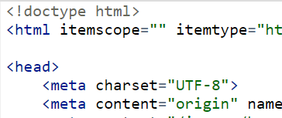
Front-end Development
Traditional Model:
Request
Response
User seeks a webpage
Server responds with HTML

Slide 6
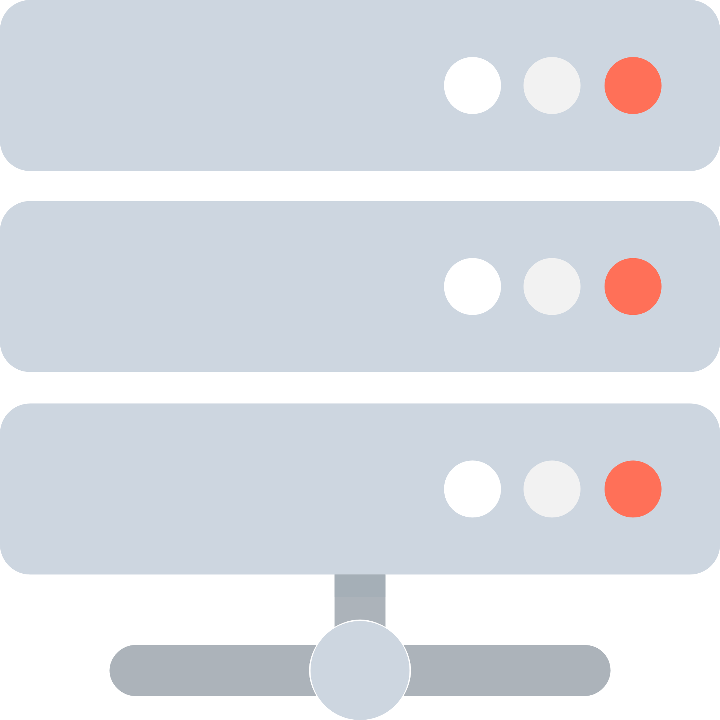

Front-end Development
User requests: www.domain.com
Modern Approach
Subsequent requests are made by the Angular app
Backend Server
Frontend Server
Synchronous requests by user
Asynchronous requests by app
Request
Request
Response
Response
Data in JSON
Angular app

Slide 7
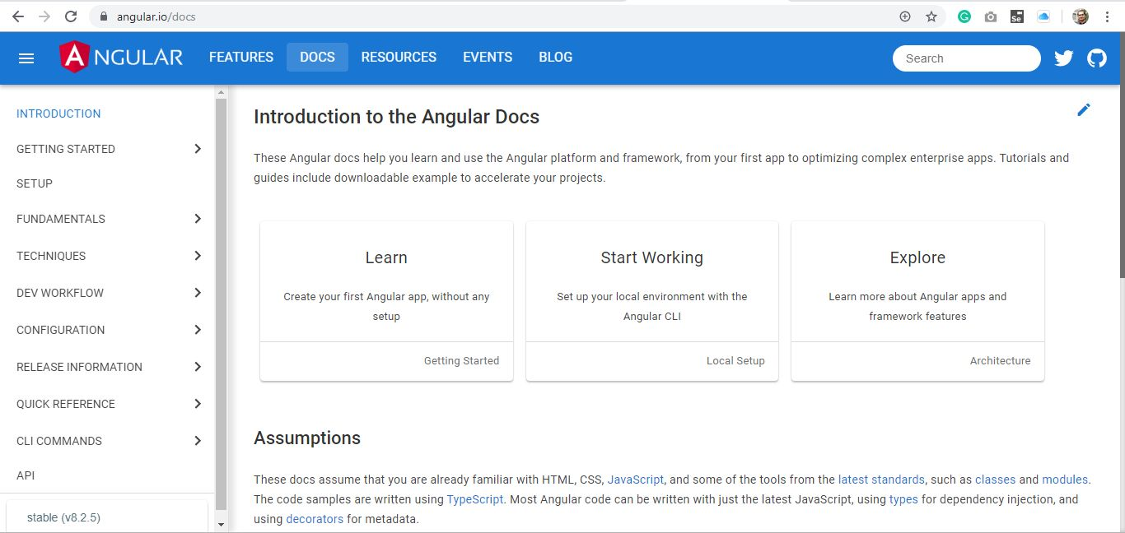
Component-based Architecture
Item
Navbar
Sidebar
Card
Main content

Slide 8


Main Contenders
Google | Facebook | Evan You
2016 | 2013 | 2014
8.2 | 16.9 | 2.6

Slide 9
Why Angular?
Framework (batteries included!)
TypeScript
Matured (learnt enough lessons!)
Backed by Google
Large ecosystem of libraries
Modularity
Dependency injection

Slide 10
Challenges
Learning curve
Conventions
Iterative learning
New language to work with

Slide 11
Solution
Learning Curve
Embrace iterative learning
Convention
Learn the idioms
New Language
It’s easy and is here to help

Slide 12
Environment Setup
Install Node.js LTS (10.16+)
Ensure (in terminal/command prompt):
node --version
npm –version
Windows: npm i -g @angular/cli
Mac: sudo npm i -g @angular/cli
Ensure (in terminal/command prompt):
ng --version

Slide 13
Editor Setup
Install Visual Studio Code
In Extensions [optional]:
Prettier – Code Formatter
Angular 8 Snippets (by Mikael Morlund)
Angular Essentials (by John Papa)
Angular Snippets (Version 8) (by John Papa)
Code Spell Checker (by Street Side Software)
Material Icon Theme (by Philipp Kief)

Slide 14
Editor Setup - Continued
In File > Preferences > Settings:
Search Font [optional]:
Editor: Font Size: 20
Terminal > Integrated > Font Size: 20
Search Format:
Editor: Format on Paste (check)
Editor: Format on Save (check)
Editor: Parameter Hints: Enabled (check)
Search Quote:
JavaScript > Preferences > Quote Style: (single)
TypeScript > Preferences > Quote Style: (single)
Prettier: Single Quote (check)

Slide 15
Npm – What is it all about?
Used to be called: Node Package Manager. Not anymore!
Package manager for JavaScript package (like Maven, or Nuget)
Maintains the project dependencies under package.json
~ (tilde) accepts only the patch increments (restrictive)
^ (caret) accepts any version greater than equal (relaxed)
package-lock.json maintains the complete set of internal dependencies (exact versions)
npm maintains the local repo as node_modules, which is usually under .gitignore
On clone, we repopulate the local repo by npm install
Corporate firewalls may block the npm central repo access. Proxy setup is required.

Slide 16
Creating Angular App
Inside a suitable directory: ng new my-app
Do not select Router
Select CSS for styles
Angular convention is to use dash-separation for words. All lowercase. No digit allowed in the beginning (1-app ⊗) or just after the dash (app-12 ⊗).
This will setup an npm project and install all the dependencies required for Angular app. Make sure your firewall doesn’t block (setup proxy if it does). It takes time!
Once completed, my-app is created in its own directory:
cd my-app
code .

Slide 17
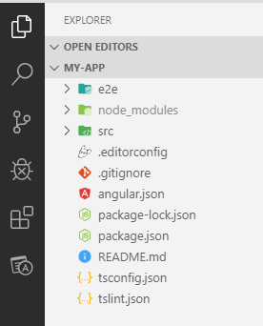
Demo: Project Walkthrough
End-to-end test files (protractor tool)
npm local repo
Project source files
Charset, indentation, etc
Angular project settings
TypeScript compiler settings

Slide 18
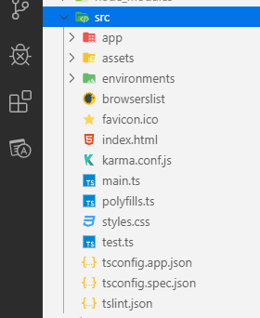
Demo: Project Walkthrough (src directory)
AppComponent (root component)
Static files
Different environments: dev, production, …
The only HTML file!
Karma test-runner config
Entry point for Angular
For older browsers
Global style sheet
Loads all spec files for Karma

Slide 19
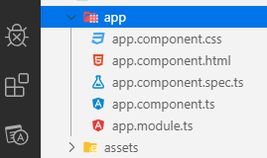
Demo: Project Walkthrough (app directory)
Component-specific style sheet
Component-specific template (view)
Unit-test file for the component
Angular Module (root module). One ring to rule them all!
TypeScript class for the component (code-behind)

Slide 20
Angular Bootstrapping
Step 1: Angular loads main.ts
Apply production specific settings defined in angular.json
if (environment.production) {
enableProdMode();
}
platformBrowserDynamic()
.bootstrapModule(AppModule)
.catch(err => console.error(err));
Load the AppModule (root module)
Global error handler

Slide 21
Angular Bootstrapping
Step 2: Angular reads the metadata of AppModule
Decorator in Angular
Declarables: @Component, @Directive, @Pipe
@NgModule({
declarations: [
AppComponent
],
imports: [
BrowserModule
],
providers: [],
bootstrap: [AppComponent]
})
export class AppModule { }
Importables (@NgModule): built-in, third-party, feature modules
The component to bootstrap
@Injectable (legacy?)

Slide 22
Angular Bootstrapping
Step 3: Angular processes AppComponent
Component-specific selector to be used in HTML
Specific template associated with the component
@Component({
selector: 'app-root',
templateUrl: './app.component.html',
styleUrls: ['./app.component.css']
})
export class AppComponent {
title = 'my-app';
}
Style sheets specific to the component

Slide 23
Angular Bootstrapping
Step 4: Angular processes index.html
Find the component with this selector and place the component’s template here
...
<body>
<app-root></app-root>
</body>
</html>

Slide 24

Moment of Deliberation
Please go through the project structure and recognise the different parts of the angular app
Take a deeper look at src directory
Understand how Angular bootstraps (or starts up itself):
main.ts
app.module.ts
bootstrap[AppComponent]
app.component.ts
selector and templateUrl
index.html and <app-root></app-root>
angular-reference/01Bootstrap.md

Slide 25
Component-based Design Strategies
We start with a root component. In our case it is AppComponent
Typically, the root component is the representation of the Single Page Application (SPA)
In a traditional application we have a multi-page, resource-based navigation. In SPAs we have only one page (index.html) and based on the usage context, we create a component-based navigation. The core idea is that the page never reloads.
Components in this respect are representatives of different capabilities of the app, such as navbar, sidebar, page-holder, etc.
Components should be reusable, flexible, extensible in order to achieve rapid application development and maintainability
We create components so that they can be composed of other components

Slide 26
Component-based Design Strategies: Continued
Seen from the application perspective, we have a tree-like structure of the components in which AppComponent is at the root. This also sets the parent-child relationship down the line. Take a look at this:
app
navbar
sidebar
main-content
page-holder
ad-panel
footer
in-focus
selected-post
angular-reference/02ComponentDesign.md

Slide 27
Value Binding
Browser
…
<element>
{{ value }}
</element>
…
Component
…
value = 1;
…
{{ value }}
angular-reference/03ValueBinding.md

Slide 28
Property Binding
Child
@Input() prop;
…
Parent
…
value = 1;
…
<app-child [prop]=“value”>
angular-reference/07PropertyBinding.md

Slide 29
Component Life-cycle so far…
constructor()
ngOnChanges()
ngOnInit()

Slide 30
Event Binding: Basic
Browser
…
<element>
</element>
…
Component
…
handler(args) {...}
…
(event)=“handler($event)”
angular-reference/08EventBindingPart1.md

Slide 31
Event Binding: Child to Parent
Child
…
cHandler() { this.ce.emit()
}
…
Parent
…
pHandler(args) {...}
…
<app-child (ce)=“pHandler($event)”>
angular-reference/09EventBindingPart2.md

Slide 32
Content Projection
Child
<ng-content>
</ng-content>
…
Parent
<app-child>
<h2>Hi there</h2>
</app-child>
angular-reference/10ContentProjection.md

Slide 33
Template References
Template
angular-reference/11TemplateReferences.md
#tr
Component
@ViewChild(‘tr’)

Slide 34
Angular Directives
Template
angular-reference/12BuiltInDirectives.md
13CustomDirectives.ms
Host
Directive
@HostBinding()

Slide 35
Important Angular Built-in Directives
Directive | Type | Purpose | Notes
ngClass | Attribute | Set css classes | String, string[], object
ngStyle | Attribute | Set individual style | Object
disabled | Attribute | Toggle disabled property | Boolean
readOnly | Attribute | Toggle readonly property | Boolean
class/class.x | Attribute | Set css class | String/Boolean
style.x | Attribute | Set style | Booean
*ngIf | Structural | Conditional rendering | Boolean expression
*ngFor | Structural | Render list | let el of list
ngSwitch | Attribute/Structural | Conditional rendering | Works with *ngSwitchCase and *ngSwitchDefault

Slide 36
Q & A for Day 1

